Slide 1


Audio/Video System
Quick Reference Guide
Large Conference Room

Slide 2


Welcome Page
When approaching the control panel it may be blank. Touch anywhere on the display section to bring up the start page.
To use the Display System press the Start System Button.

Slide 3
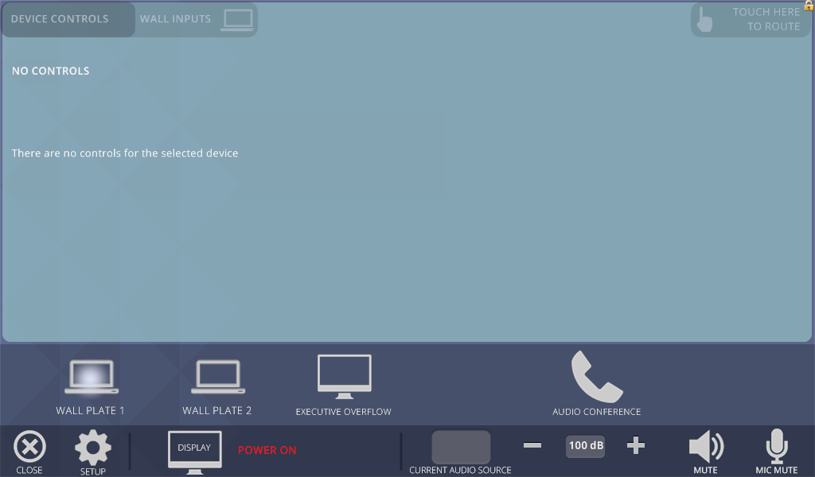
Main Page
Brings up the Routing Page
Sources
Mutes Microphone Audio
Brings up the Confirmation Page
Shows the Current Audio coming over the Speakers
Mutes Program Audio
Brings up the Setup Page
Raises the Program Audio
Shows the Display Power status and the Phone Call Status
Lowers the Program Volume
Shows the Program Volume Level
After Pressing the Start System Button, The Main Page will appear. Selecting a Button on the Bottom will allow you to choose what Video Source you want to see.

Slide 4
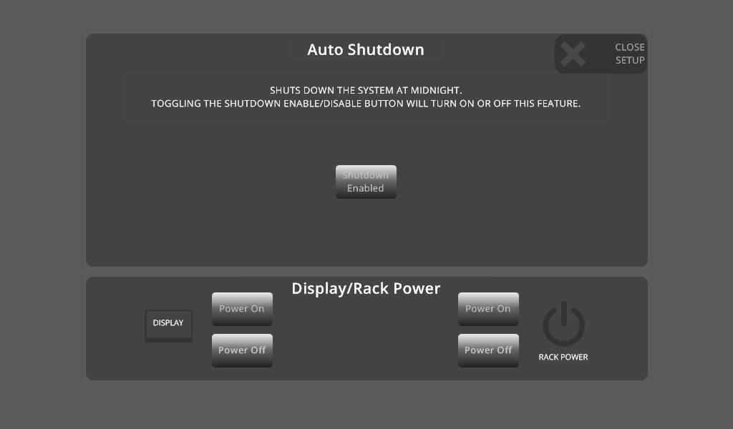
Setup Page
Press this to close the Setup Page
Auto Shutdown Control Button
Controls the Power to the Sharp Display in the Room
Controls the Power to the Sharp Display in the Room
After Pressing the Setup Button, the Setup Page will appear. Here you can control the Display Power, Rack Power, and the Auto Shutdown Routine. Here you can enable/disable the Auto Shutdown, Turn on and off the Display, and Turn Power On and Off to the Rack.

Slide 5
Wall Plate Input 1 Page
Wall Plate 1 Input Source Button
After Pressing the Wall Plate 1 Button, the Wall Plate Input 1 Page will appear. This will cause the Stage Left Wall input to appear on the Main Screen.

Slide 6
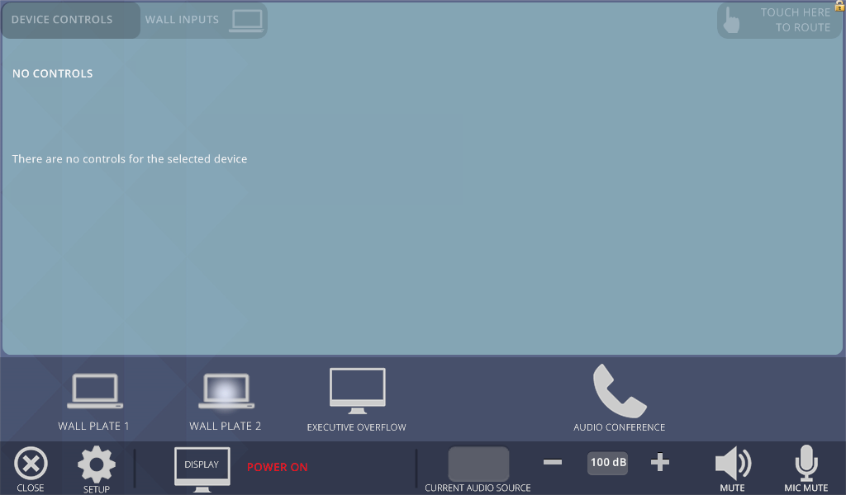
Wall Plate Input 2 Page
Wall Plate 2 Input Source Button
After Pressing the Wall Plate 2 Button, the Wall Plate Input 2 Page will appear. This will cause the Stage Right Wall input to appear on the Main Screen.

Slide 7
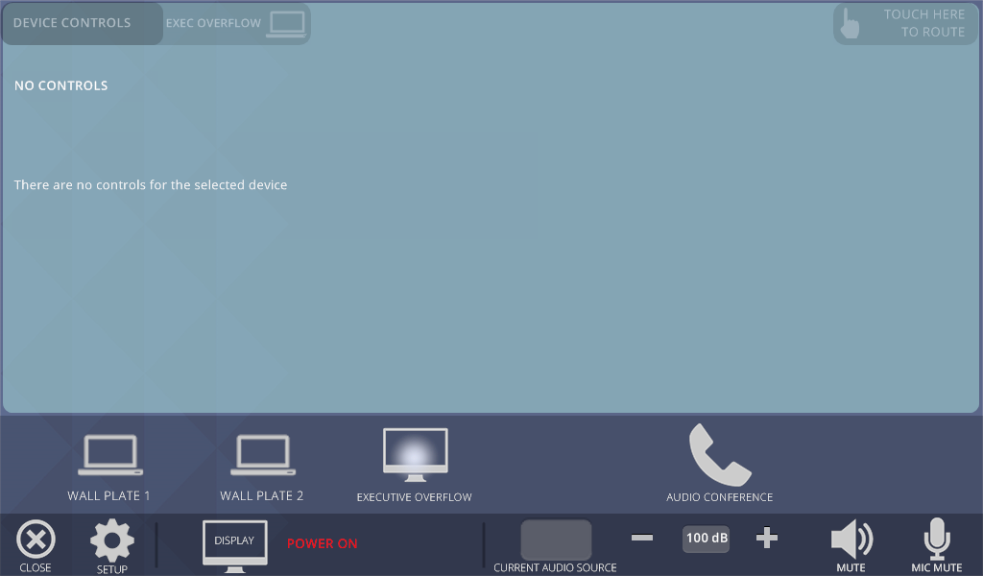
Executive Overflow Input Page
Executive Overflow Input Source Button
After Pressing the Executive Overflow Button, the Executive Overflow Page will appear. This will cause the Source in the Pacific Conference Room to appear on the Main Screen (If enabled on the Pacific Panel). It will also send any Audio in the Pacific Conference Room into the Large Conference Room.

Slide 8
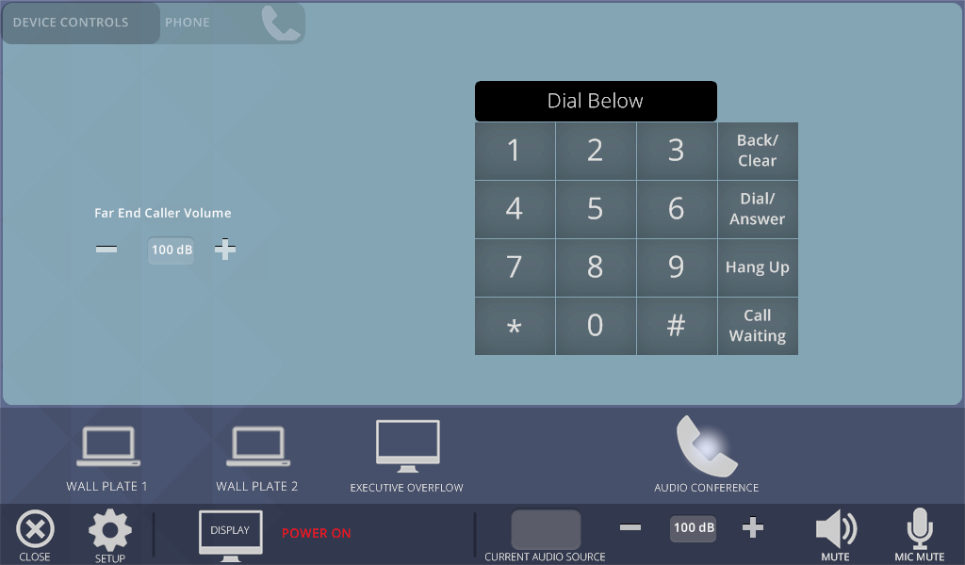
Phone Page
The Current Dialed Number is Shown here.
Dialing Buttons
Raises the Caller’s Audio
Lowers the Caller’s Audio
Caller’s Audio Level
Phone Source Button
After Pressing the Phone Button, the Phone Page will appear. Use the Dialing Buttons to dial Traditionally.

Slide 9
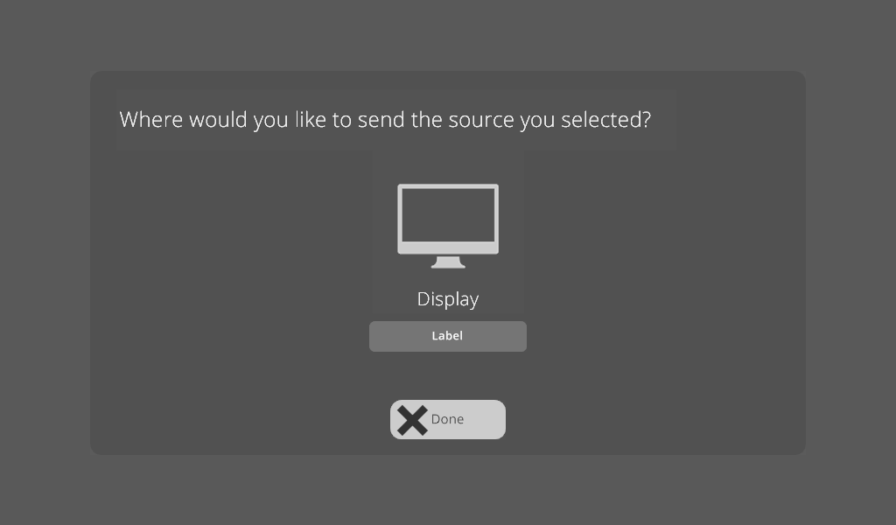
Routing Page
Destinations
Shows the Source showing on the Screen
This closes the Routing Page
After Pressing the “Touch Here to Route” Button, the Routing Page will appear. Pressing one of the Destination Buttons will allow the source to be seen on that Screen. Pressing and holding a Destination Button will remove it from the Screen.

Slide 10

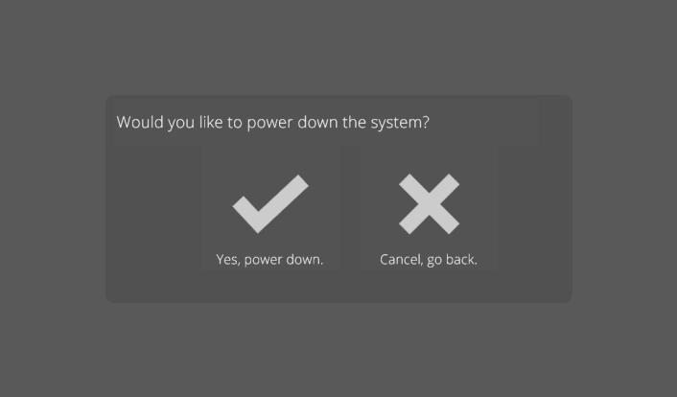
Power Down Page
From the Main Page press the Close button.
Then press the “Yes, Power Down” button to turn the system off.

Slide 11
Service Resource Guide
Monitor is on but no image
Are all cables properly connected
Is laptop output toggled on?
Is the device turned on?
Call our office for service (336) 714-0564
I see the image but hear no sound
Check the “mute” button
Select and press volume up then volume down
Has someone turned the amplifier off at the rack
Call our office for service (336) 714-0564

Slide 12
Service Resource Guide
Nothing works
Was system power turned on from the touch panel power page?
Was there a recent power failure or surge. Check the power at the rack. Insure the power cord is plugged in?
Turn the rack off (Unplug the rack, then re-plug). The system may need to be re-set wait 90 seconds then try the touch panel.
Call our office for service (336) 714-0564

Slide 13
For Service, contact:
Tonya Allen at
(336) 714-0564 tonyaa@strategicmail.net

Slide 14
For Sales Contact:
Dan Williams at (919) 900-4001
DanW@strategicmail.net

